Slide 1


Materials Science and Nanotechnology
Al-Karkh University of Science
College of Science
Department of Medical Physics
Asst. Prof. Ali J. Mohammed
Lecture One
Introduction to Materials Science
Medical Physics Dept. , 2nd stage, 1st semester, 2018-2019

Slide 2

Preview
Text book and references
- materials Science and Engineering: An Introduction, William D. CallisterJr. And G. Rethwisch, 2010
Suggested references:
- Fundamentals of Materials Science and Engineering, 5th Edition, 2000.
- Materials Science, S. L. Kakani and Kakani Amit, 2010.
- Elements of Materials Science and Engineering, Lawrence H. Van Vlak, 1984
Medical Physics Dept. , 2nd stage, 1st semester, 2018-2019

Slide 3
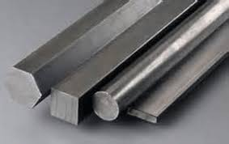

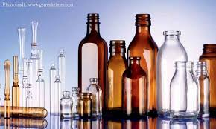
Chapter One
Introduction to Materials Science
Introduction
Structure: properties and performance
* 2000 types of steel
* 5000 types of plastic
* 10000 kinds of glass
Medical Physics Dept. , 2nd stage, 1st semester, 2018-2019

Slide 4

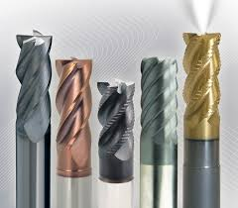
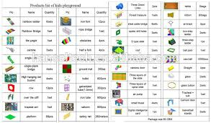
internal structure and properties
- production
- hard materials
- soft materials
- properties and processing
Strength
Hardness
Conductivity [thermal, electrical, ….]
Density
Optical
Structural
Mechanical
Medical Physics Dept. , 2nd stage, 1st semester, 2018-2019

Slide 5
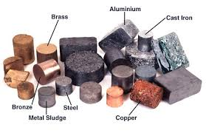
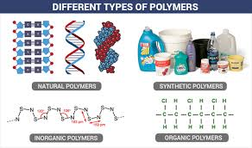
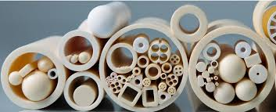
Types of Materials
Metals
Polymers (plastics)
Ceramics
Medical Physics Dept. , 2nd stage, 1st semester, 2018-2019

Slide 6
Selected Properties of Materials
Review of selected properties of materials
Conductivity (σ) [(and resistivity (ρ)]
Electrical
R= ρ (L / A) (Ω)
σ = 1 / ρ (Ω.cm)⁻¹
Thermal (expressed as power density)
k = P / A (W/m²)
in terms of temperature gradient: (W/m.Kº)
Note: thermal resistivity is not the reciprocal of thermal conductivity
Medical Physics Dept. , 2nd stage, 1st semester, 2018-2019

Slide 7
Stress and strain
stress: force per unit area
S = F / A (N/m²)
strain: dimensional response to stress
ϱ = ΔL / L
positive strain: under tensile stress
negative strain: under compressive stress
Note: elastic strain is reversible and linear function of stress (Hook’s Law).
The modulus of elasticity (Young’s modulus E)
E = S / ϱ (pressure units)
Medical Physics Dept. , 2nd stage, 1st semester, 2018-2019

Slide 8
Plastic strain: the stress exceeds a critical value that initiates a permanent displacement of atoms from their neighbors.
Strength: is the critical stress required to initiate failure.
Hardness: is the resistance of a material to penetration.
Ductility: is the permanent strain that a companies fracture
a measure of ductility is the reduction of area (R of A)
R of A= (A_{o} – A_{f}) / A_{o}
Elongation: is the linear strain for fracture (ΔL_{f}L_{o})
Medical Physics Dept. , 2nd stage, 1st semester, 2018-2019

Slide 9
Toughness: is the energy for failure by fracture.
Note: in brittle materials, which lack plastic deformation, and therefore are non ductile, the toughness can be calculated from the area under the (stress – strain) curve.
The unit of toughness is (Joule per unit volume)
Example(1): A copper wire has a diameter of 0.9 mm
What is the resistance of a 30 cm wire?
How many watts are expended if 1.5 volts dc are applied across 30 m of this wire?
Medical Physics Dept. , 2nd stage, 1st semester, 2018-2019

Slide 10
Examples
Example (2): which part has the greater stress:
A rectangular aluminum bar of (24.6 mm x 30.7mm)cross section, under a load of 7640 kg, and therefore a force of 75000 N?
A round steel bar whose cross sectional diameter is 12.8 mm, under a 5000 kg load?
Example (3): a 50 mm gauge length is marked on a copper rod. The rod is strained so that the gauge mark is 59mm apart. Calculate the strain.
Medical Physics Dept. , 2nd stage, 1st semester, 2018-2019

